Slide 1



CONCRETE COMPRESSIVE STRENGTH

Slide 2






1- Problem Definition
2- Dataset Exploring
Agenda
3- Data Preprocessing
4- ML Model
5- Deployment

Slide 3


Introduction
In recent years, the sector that Egypt has been focusing on most is..?

Slide 4
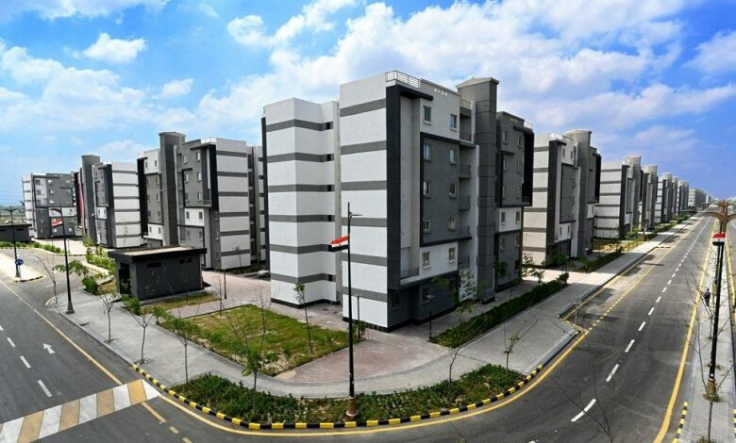

Introduction
Urban Construction
Roads and Bridges
Concrete is the foundation of construction but..

Slide 5
Problem Definition
Concrete
The process of monitoring the strength of concrete requires a lot of time and effort from quality engineers and leads to wasting resources, as it is implemented in multiple stages, which delays deliveries and there are projects that depend on concrete.

Slide 6


Market Analysis
Ready-mix concrete companies
200–300 companies

Slide 7
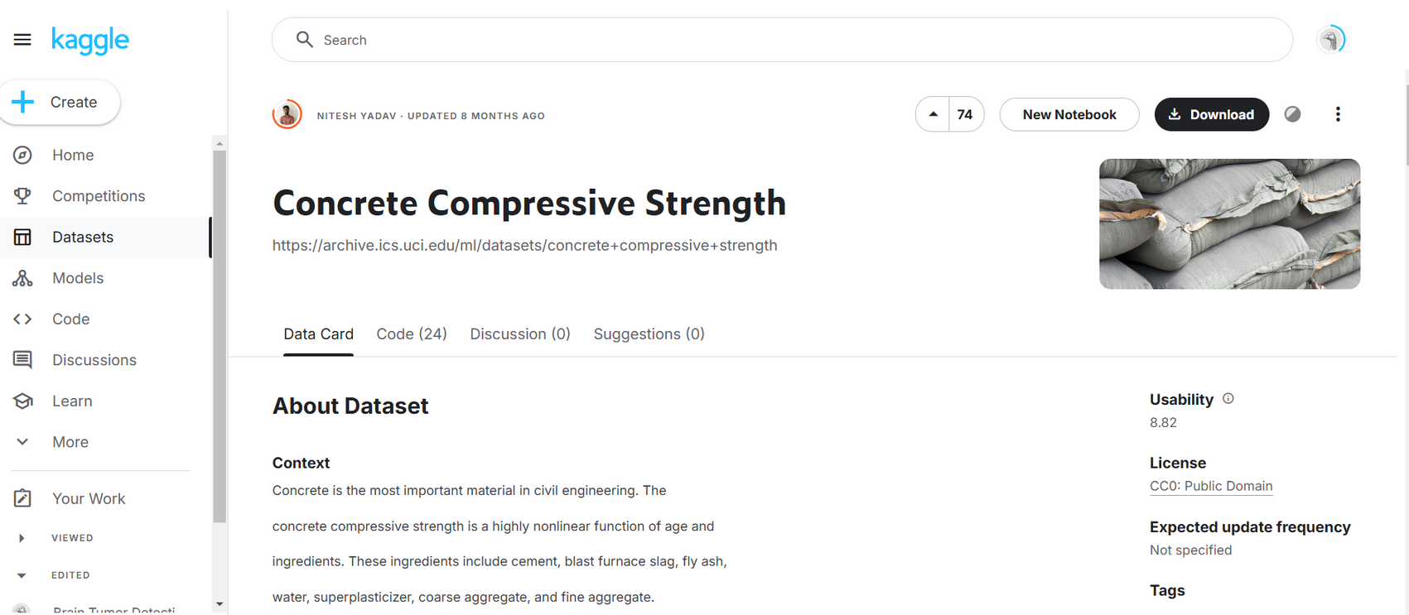
Dataset Exploring
We have 1030 different concrete samples & 9 different features
All features are numeric
8 different features that affect strength of concrete
Target feature to predict: Strength

Slide 8
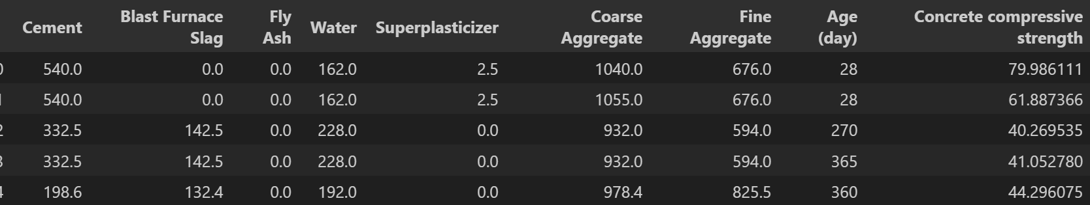
Dataset Exploring
Features
Target

Slide 9
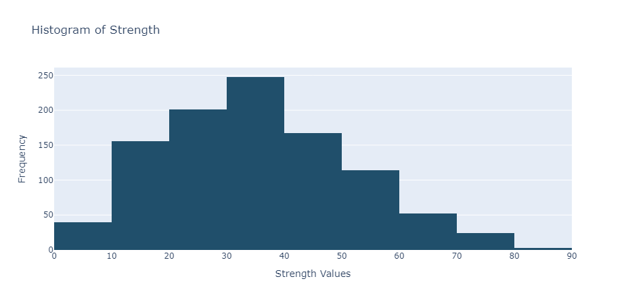
Dataset Exploring
Strength Ranges

Slide 10
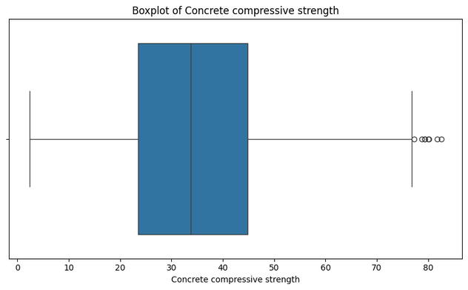
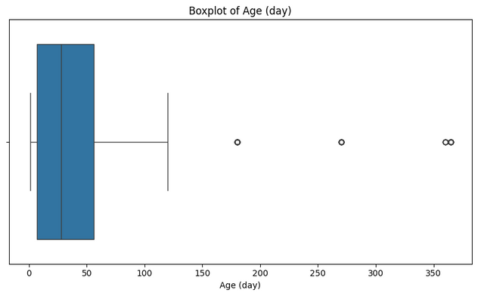
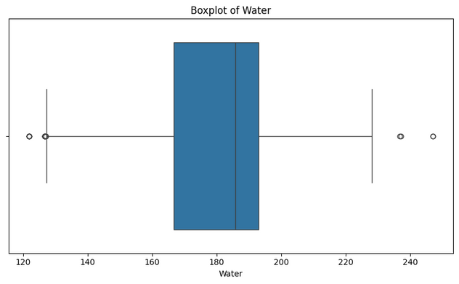
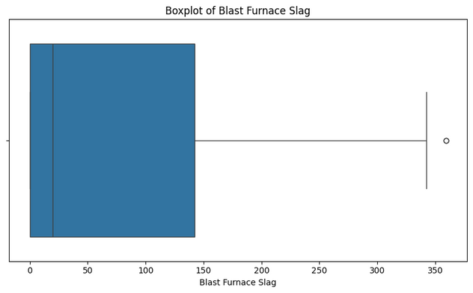
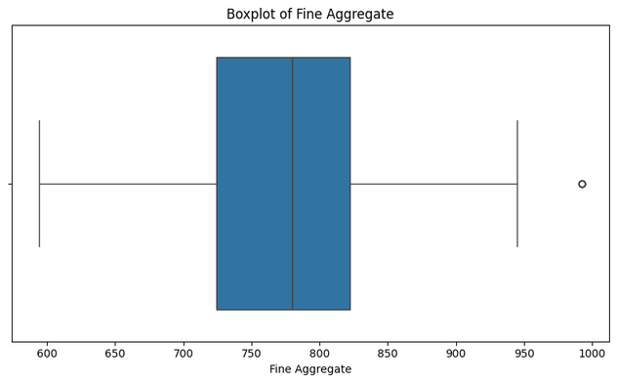
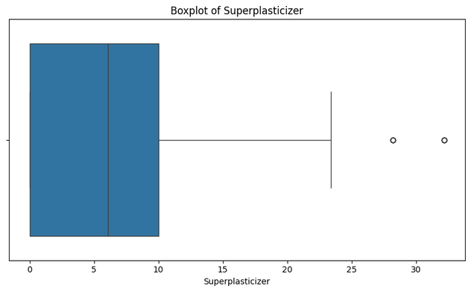
Data Preprocessing

Slide 11
Data Preprocessing
Number of duplicates: 25 duplicate rows
No nulls
Having Some outliers in dataset and dealing with them by log10 transformation

Slide 12
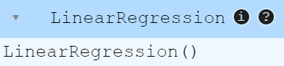
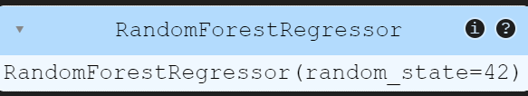
ML Model
Mean Absolute Error (MAE): 8.683121870900775
Root Mean Squared Error (RMSE): 11.008716887022368
R² Score: 0.5937632978451237
Mean Absolute Error (MAE): 3.4411994078218746
Root Mean Squared Error (RMSE): 5.161319363514516
R² Score: 0.910704984552392

Slide 13

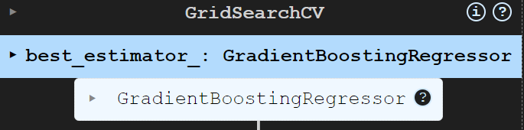
ML Model
Mean Absolute Error (MAE): 2.738200859575628
Root Mean Squared Error (RMSE): 4.5383402559952515
R² Score: 0.9309601468942102
Best RMSE: 4.263563792059502
Best R²: 0.9390671793574016

Slide 14
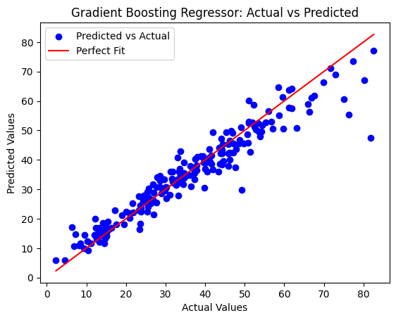
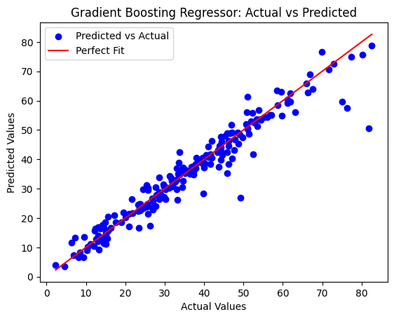
Best Model

Slide 15
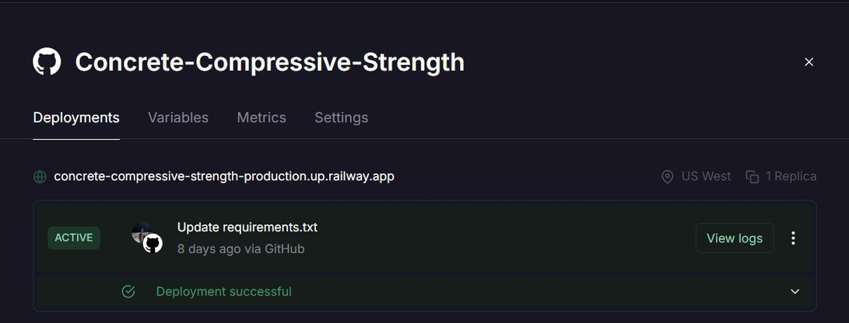
Deployment
Flask code for API
Deploy on Railway server
Deploy URL

Slide 16

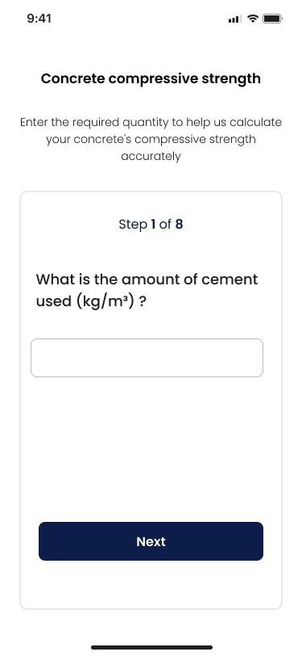
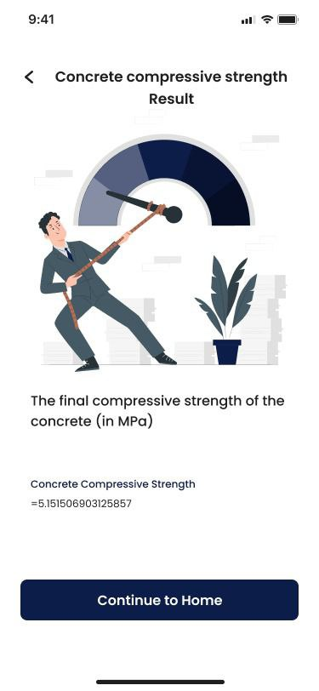
Deployment

Slide 17







MEET OUR TEAM
MOSTAFA NAFEA
MAHMOUD OSAMA
IBRAHIM HEGY
IBRAHIM MAGDY
FLUTTER
TASNEEM GAMAL

Slide 18
THANK YOU
For Your Attention

